Slide 1

GLP Bucket App Design Brief

Slide 2
Vision:
I wanted a design that stayed true to the aesthetic of the GLP website and jonathanfields.com. I chose a sans serif typeface and neutral grays as the dominant screen colors for a look that was clean and modern. Each bucket was assigned a color that shows up as accent text or brand items from the website. (Tones were adjusted as necessary to help them play well together.) The overall design was kept clean, non-gimmicky, and simple to use.
The app allows the user to enter daily activities and tracks three features for each one: the bucket(s) that it belongs to, the time spent, and the bucket quality for each activity.
For example, a user might spend 4 hours in a meeting that is excellent for connection, but terrible for vitality; separating the quantity and quality of time spent allows the app to capture both aspects.
The color of the quality indicators were chosen to reflect a universally accepted ordering scheme: red is poor, yellow intermediate, and green is good quality. These colors were later expanded to allow a 5-point rating system.
The activities for each day are summarized in the “Daily” tab, and the “Weekly” view shows plots of either quantity or quality, to allow behavior tracking over time.

Slide 3
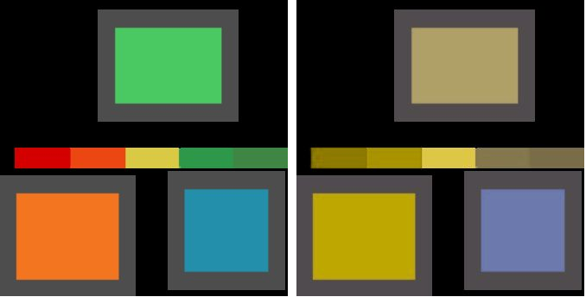
Accessibility:
The color scheme was run through vischeck.com to check for accessibility to users with different forms of colorblindess. Due to similarities in the color intensity, there was some room for confusion between the main bucket colors and the rainbow colors used in the quality ranking.
In the user entry page of the app, text prompts were included to define the meaning of each location on the quality slider. Consistent positioning of colors on different pages allows colorblind users to spatially interpret meaning, and additional symbols were added to the log page for cases where additional color distinction is necessary.
App color palette
Deuteranope simulation

Slide 4
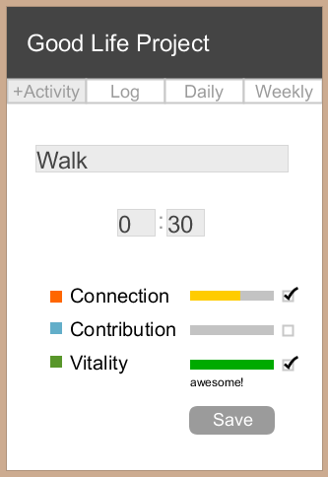
The +Activity page allows the user to input a new activity into the database. The activity is given a name and a duration (in hh:mm), and then scored with a connection, contribution, and vitality value.
When the user moves the mouse over one of the sliders, a text indicator is displayed to define the meaning of that value. If one of the buckets is not applicable to this activity, the user can uncheck the check box, and the value will not be recorded.
Pressing “Save” automatically loads the “Log” page.

Slide 5
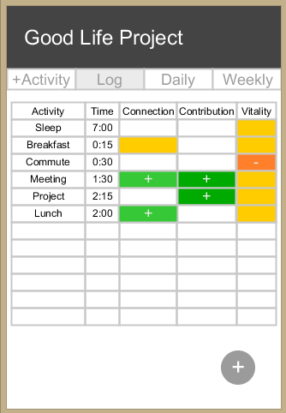
The “Log” page auto-loads when the user hits “Save” on the +Activity page, or it can be loaded by clicking on the navigation tab at the top of the window.
The log displays all activities entered for the current day, along with the time spent on each activity and the scores for each bucket. Positive scores have a small “+” symbol on top of the color, and negative scores have a “-” symbol. If no score was entered for a particular bucket, then the spreadsheet location remains blank.
Pressing the “+” button at the bottom of the page loads the “+ Activity” page, so that the user can make a new entry.

Slide 6
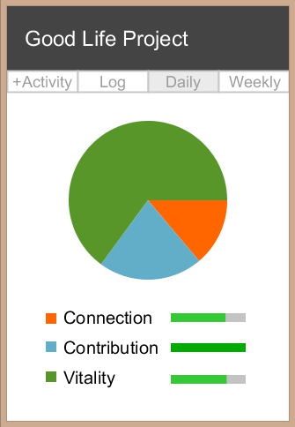
The “Daily” page features a pie chart that summarizes the total time spent filling each bucket during the current day. Since one activity can count for multiple buckets, the value shown is a percentage of the total number of hours recorded for all buckets (duplicates count twice toward the total time - once for each bucket listed).
The legend identifies the meaning of each color in the pie chart, and the slider bars next to the legend indicate the cumulative quality score for each bucket on this day.

Slide 7
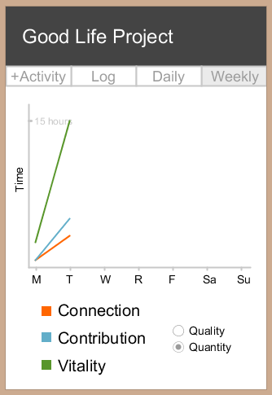
The “Weekly” page has two separate modes, which can be toggled using the radio button on the bottom left of the screen.
The “Quantity” view shows the total number of hours spent on each bucket for each day of the current week. (Activities that count toward multiple buckets will be added to all of the relevant totals.) The y-axis value is determined based on the highest number of hours spent on any one activity, and the weekly max is indicated with text on the y-axis to give a sense of scale.

Slide 8
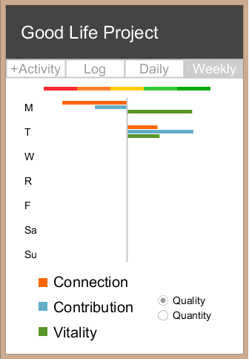
The “Weekly Quality” page shows the cumulative quality rankings for all activities on each day of the current week. The chart axis is positioned at the center of the slider rainbow legend. Any values plotted to the right of the line are higher than average, and any to the left are lower than average.

